Slide 1
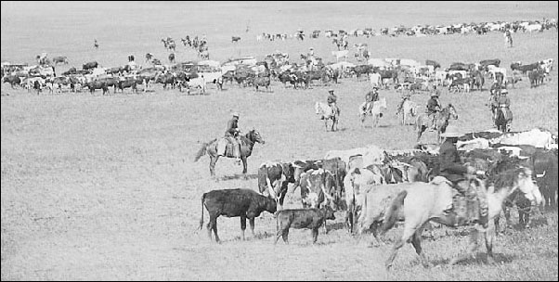
Wednesday, Nov. 8
Do Now

Slide 2
SS5H1
Cattle
Trails
© 2014 Brain Wrinkles

Slide 3
More Beef
After the Civil War, Texas ranchers returned home to cattle herds that had grown tremendously while they were away at war.
Because there were so many cows, the price of beef plummeted in Texas.
© 2014 Brain Wrinkles

Slide 4
Demand in East
Fortunately, there was a huge demand for beef in the East.
The Civil War soldiers had eaten most of the beef there.
Longhorn cattle sold for $4 in Texas and $40 in eastern states.
The only problem—how to get the cows across the country?
© 2014 Brain Wrinkles

Slide 5
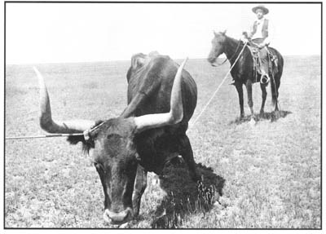
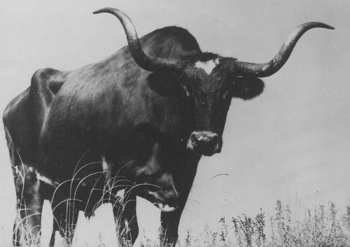
Texas Longhorns
© 2014 Brain Wrinkles

Slide 6
McCoy’s Idea
A young cattle shipper from Illinois named Joseph McCoy, came up with the idea to guiding herds of cattle north through Texas and Oklahoma, and ending in railroad towns in Kansas.
In Kansas, the cattle would be placed on trains and transported east.
© 2014 Brain Wrinkles

Slide 7
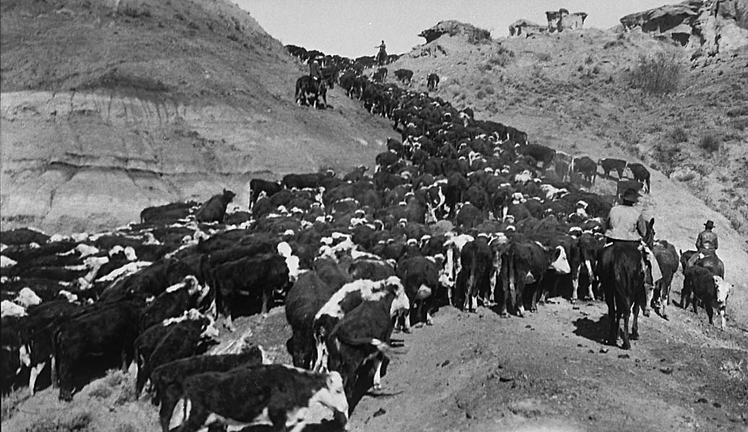
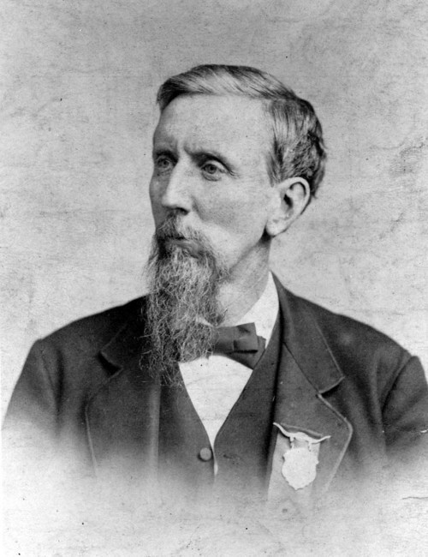
Joseph McCoy
© 2014 Brain Wrinkles

Slide 8
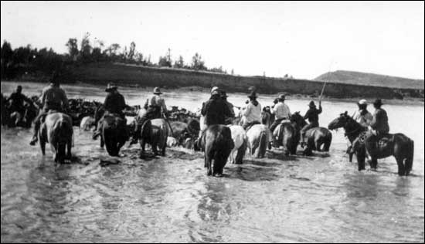
Crossing the Colorado River on the Chisholm Trail
© 2014 Brain Wrinkles

Slide 9
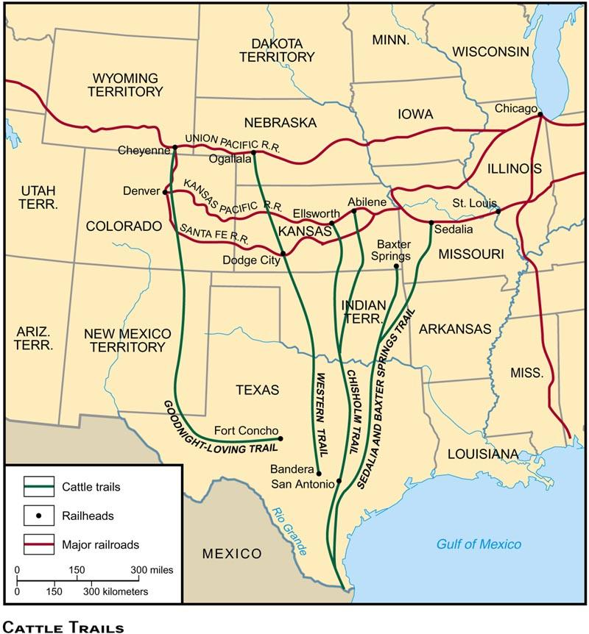
Cattle Trails
© 2014 Brain Wrinkles

Slide 10
Great Western
Cattle Trail
The cowboys needed other trails to herd cattle to the northern plains.
The Great Western Cattle Trail was established through western Texas up to Nebraska and northern territories.
This became the main trail for cattle heading to railroad loading points for northern markets.
© 2014 Brain Wrinkles

Slide 11
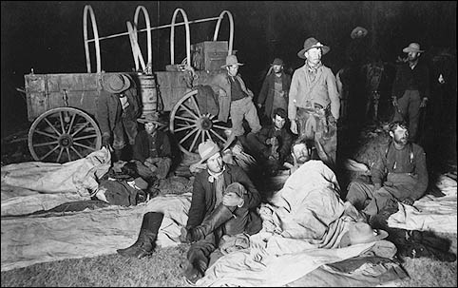
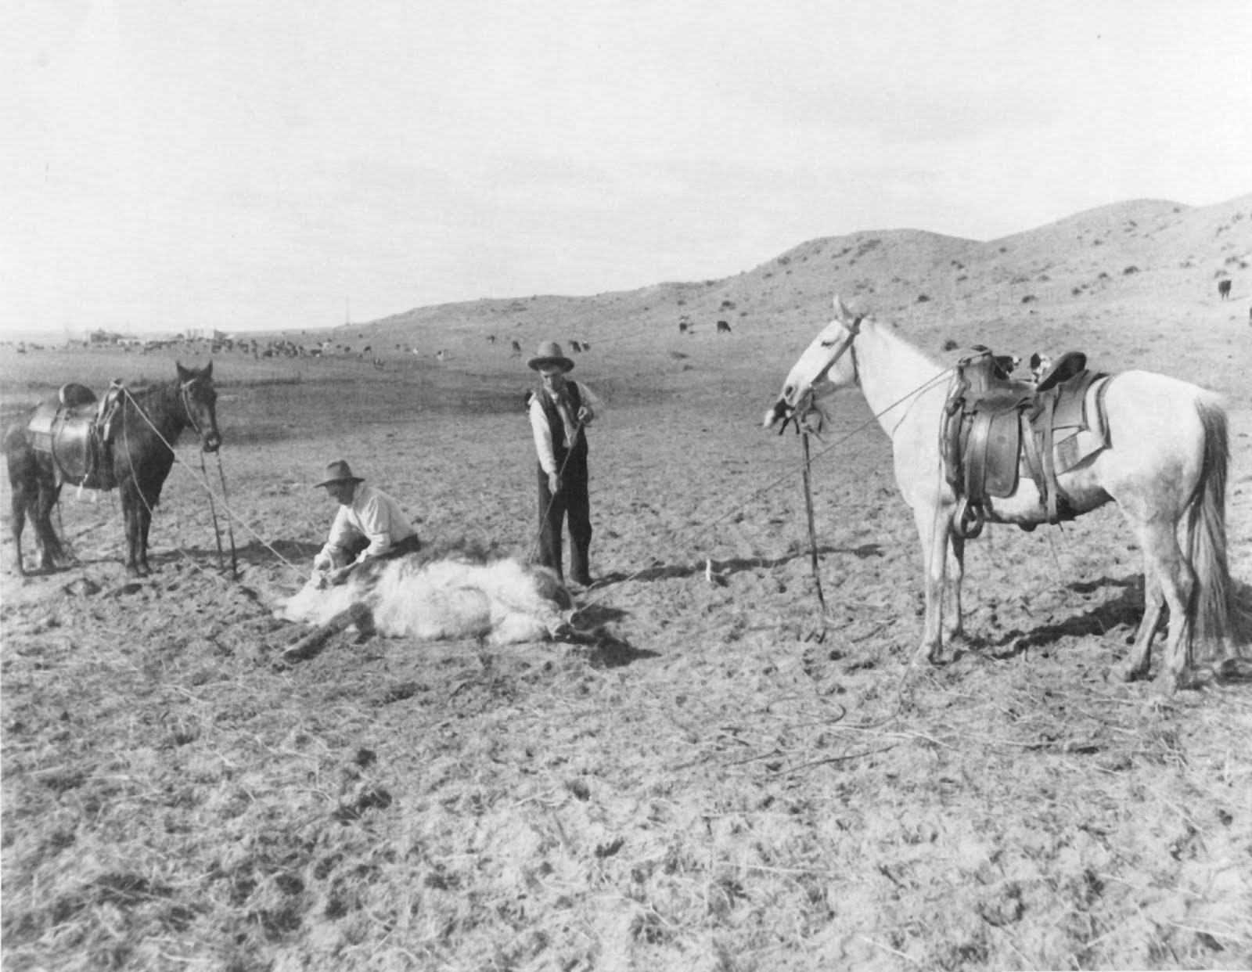
Cowboys Along the Trail
© 2014 Brain Wrinkles

