Slide 1
SS5H1: Describe how life changed in America at the turn of the century. b. Describe the impact on American life of the Wright brothers (flight), George Washington Carver (science), Alexander Graham Bell (communication), and Thomas Edison (electricity).

Slide 2
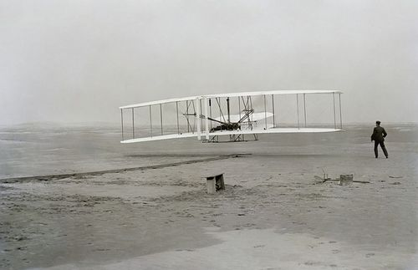
The Wright Brothers
More than one hundred years ago, two brothers stood on a sand dune at Kitty Hawk, North Carolina. Nearby was a big, odd-looking machine they had built. The brothers were Orville and Wilbur Wright. The machine was the world's first powered airplane.
Today, that amazing flying machine is on display at the National Air and Space Museum in Washington, D.C. The museum has the largest collection of historic aircraft and spacecraft in the world.
A new exhibit at the museum marks the 100th anniversary of the Wright brothers' famous flight.
The Wright brothers' flying machine looks something like a box kite with an engine. But it made all future flight possible.

Slide 3
Wheels to Wings
In 1896, the Wright brothers made bicycles in Dayton, Ohio. But they dreamed of wings, not wheels.
At that time, the only way to fly was in a basket under a hot-air balloon. Not many people did so, as the balloons were hard to control.
Orville and Wilbur set out to build a machine that could fly. It would have glider-type wings and an engine.
Designing and building the flying machine took years. When it was finally ready, bad weather set in. The Wrights had to wait months to test their invention.
Flying was a dangerous mission. Other people had died trying to fly. On December 17, 1903, however, the Wright brothers were ready to take their chances.
Orville was the machine's first pilot. His flight lasted only 12 seconds. The flyer traveled just 120 feet and landed with a thud. The flight was short but very sweet. It proved that humans could fly.
Orville and Wilbur made four flights that day. They took turns as pilots. Wilbur made the longest flight. He flew for 59 seconds and went a distance of 852 feet.

Slide 4
Roll, Pitch, and Yaw
The Wright brothers' invention began the age of flight. Their machine was important not only because it flew, but because it could be controlled in the air.
The Wrights could control their craft in three important ways-roll, pitch, and yaw. They could roll the wings right or left. They could pitch the plane's nose up or down. And they could yaw the nose from side to side.
Being able to control the plane in those three ways made all the difference. All pilots use those same controls when flying today.

Slide 5
To the Stars
After the Wright brothers' success, flying really took off.
In May 1927, Charles Lindbergh flew a small, one-seater plane across the Atlantic Ocean. He was the first person to do such a feat alone.
That plane, the Spirit of St. Louis, can be seen at the Air and Space Museum.
The museum also displays a jet named Glamorous Glennis. Its pilot was Chuck Yeager. In October 1947, Yeager flew the plane 700 miles per hour. It was the first plane to fly faster than the speed of sound. With jets, humankind pushed toward the edge of space and beyond!
In 1962, John Glenn became the first man to orbit Earth. He flew in the Mercury Friendship 7 space capsule. That tiny craft is now at the museum. The craft that first flew men to the moon is there, too.
For the Wright brothers, flight was an amazing adventure. Today, the adventure goes on. In the past hundred years, human flight has soared from Kitty Hawk to the moon!

Slide 6
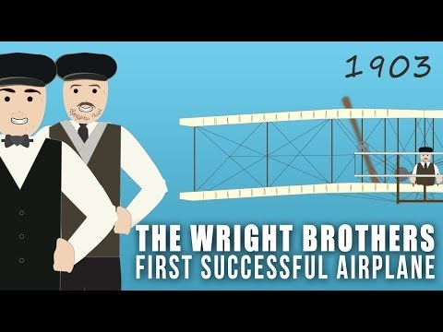
The Wright Brothers

Slide 7
The Wright Brothers
www.youtube.com/watch?v=VgeletVJiJg#action=share

